Slide 1
Low Energy consumption Regression Model
Deepmala Mehra

Slide 2
Statement of the Problem
To create regression models of appliances energy use in a low energy building.
The data set is at 10 min for about 4.5 months. The house temperature and humidity conditions were monitored with a ZigBee wireless sensor network. Each wireless node transmitted the temperature and humidity conditions around 3.3 min. Then, the wireless data was averaged for 10 minutes periods. The energy data was logged every 10 minutes with m-bus energy meters. Weather from the nearest airport weather station (Chievres Airport, Belgium) was downloaded from a public data set from Reliable Prognosis (rp5.ru), and merged together with the experimental data sets using the date and time column. Two random variables have been included in the data set for testing the regression models and to filter out non-predictive attributes (parameters).
Dataset contain 29 attributes and 19735 observations.
Link – http://archive.ics.uci.edu/ml/datasets/Appliances+energy+prediction

Slide 3
Data Wrangling
Tasks performed:
Handling inconsistent column names and datatype
Missing Data handling
Removal of duplicate rows
Handling columns with repetitive values
Handling the outliers
Write the clean data into a new file for further steps

Slide 4
EDA and Data storytelling
Tasks performed:
Handling of multicollinearity
Relationship of categorical variables
Inferential statistics

Slide 5
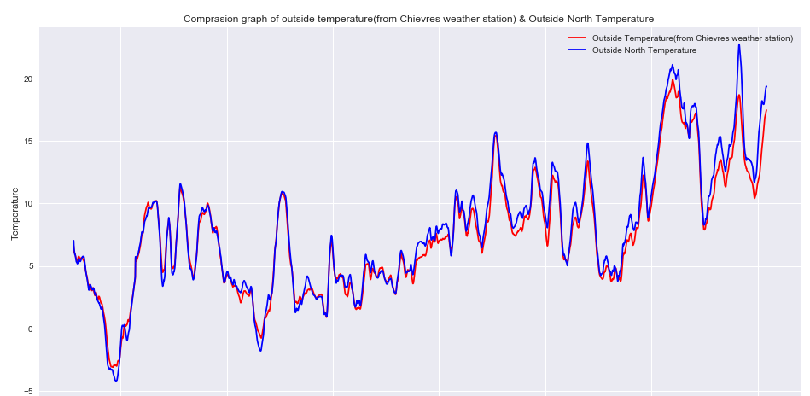
Some interesting data Facts
Graph for outside temperature (from Chievres weather station) & Outside-North Temperature is almost similar. These two attributes can be treated as co-linear. It could be a problem for our model as multicollinearity increases the variance of the coefficient estimates and make the estimates very sensitive to minor changes in the model. We will explore this point while modeling.

Slide 6
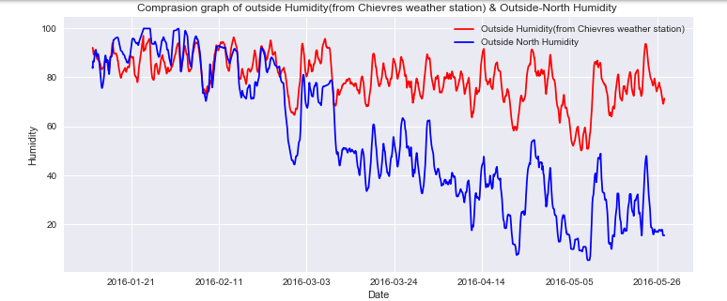
Outside Humidity (from Chievres weather station) and Building Northside Humidity was almost same but from mid of the march Building northside humidity became significantly lower than the outside humidity. Probably AC could be the reason because days are hotter after mid-March, which will be visible in temperature graph as well.

Slide 7
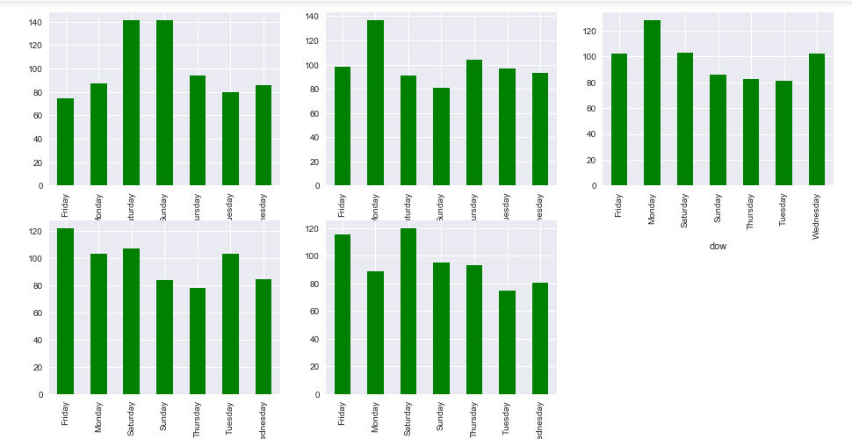
This is interesting to note here that energy consumption is not dependent on week days. Each month has different days as peak and lowest usage of energy. Jan has maximum energy usage on Saturday and Sunday and lowest on Friday, Feb has highest on Monday and lowest on Saturday. Likewise, other months has different days as maximum and minimum energy consumption.

Slide 8
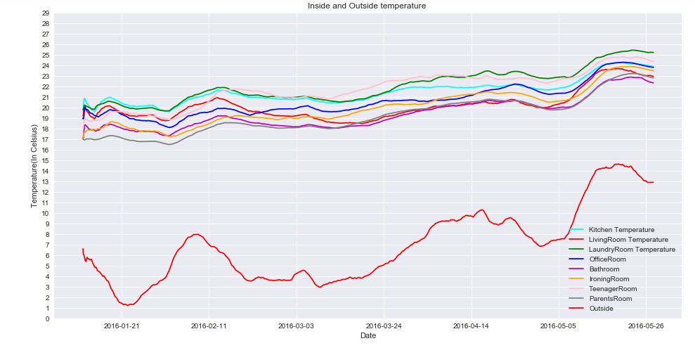
Inside temperature is always maintained between 17-25 Celsius.
Each room of the home don not have same temperature.
Parent's room is always coolest where as laundry room is the always hottest in house.

Slide 9
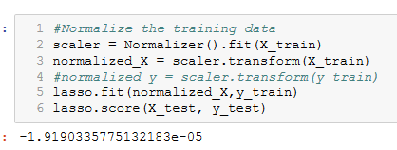
Data preprocessing steps:
Normalizing and scaling the data
Preprocessing of data using log and cube
PCA feature engineering
After preprocessing and transforming the data didn’t improvise the performance of the model. So decided to go on randomforestCalssifier.

Slide 10
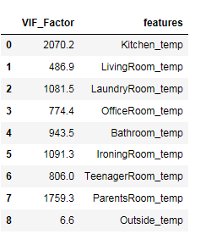
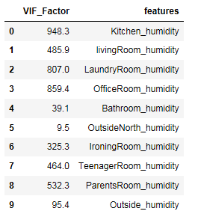
Modeling
As we saw during the EDA, there are many features which has multicollinear. These features can impact the regression model. My first approach to handle the multicollinearity was variance inflation factor. Features having VIF >5 can be considered as multicollinear.
Variance inflation factor is high for all the features. So, I cannot choose VIF for multicollinearity detection criteria.

Slide 11
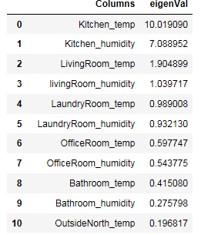
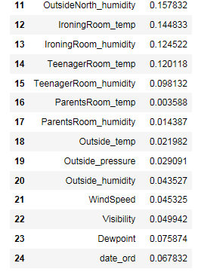
Another approach to predict multicollinearity by directly looking at the eigen vector of a correlation matrix. If at least one of the eigen values of the correlation matrix is close to zero then we can say that multicollinearity exists in the dataset.
Other than 4 features rest all are eigen values of the correlation matrix is close to 0. So, we can not decide the multicollinearity based on the eigen values.

Slide 12
L1,L2 Regularization using Lasso and Ridge
Lasso uses L1 regilraization and also helps in feature selection. I applied ridge and elasticNet techniqiues . R2 score for the Lasso, Ridge and ElasticNet models are very low and also, they have very high mean squared error value.
Lasso:
Ridge:
ElasticNet:

Slide 13
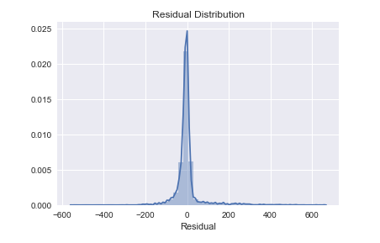
R2 score for the Lasso, Ridge and ElasticNet models are very low and also, they have very high mean squared error value. Since R2 is so low, that tuning cannot help much here. Another approach I took to transform the features before training the models. Still it didn't improvise the performance of the model. So, decided to go on RandomForestRegressor. RandomForestRegressor score was better now which is 48%. So I decided to tune this further for better result.
Tuned RandomForestRegressor:
Distribution plot of the residuals

Slide 14
Conclusion
Based on the performance of all the regression models I found Tuned RandomForestRegressor is the most suitable predictive model to choose here.
Dataset we have here is multicollinear. All the predictors are correlated with other predictors. Variance inflation factor is high for all the features. Since multicollinearity doesn't impact much to RandomForestModel as Random forests select a subset of variables to grow each tree. I believe this is the reason RandomForestRegressor worked here but not other models.

